Slide 1

Control Statement and Repetition
Presented By:
Aashish Gautam
Bikram Baral
Manish Adhikari
Prakash Gharti Magar
Sunil Bhattarai

Slide 2
Control Statement
Control statement is the statement which alter/control the flow of execution of the program.
In the absence of control statement, the instruction or statements are executed in the same order in which they appear in the program.
Types of Control Statement:
Decision → if, else, nested if
Loop → for loop and while loop

Slide 3
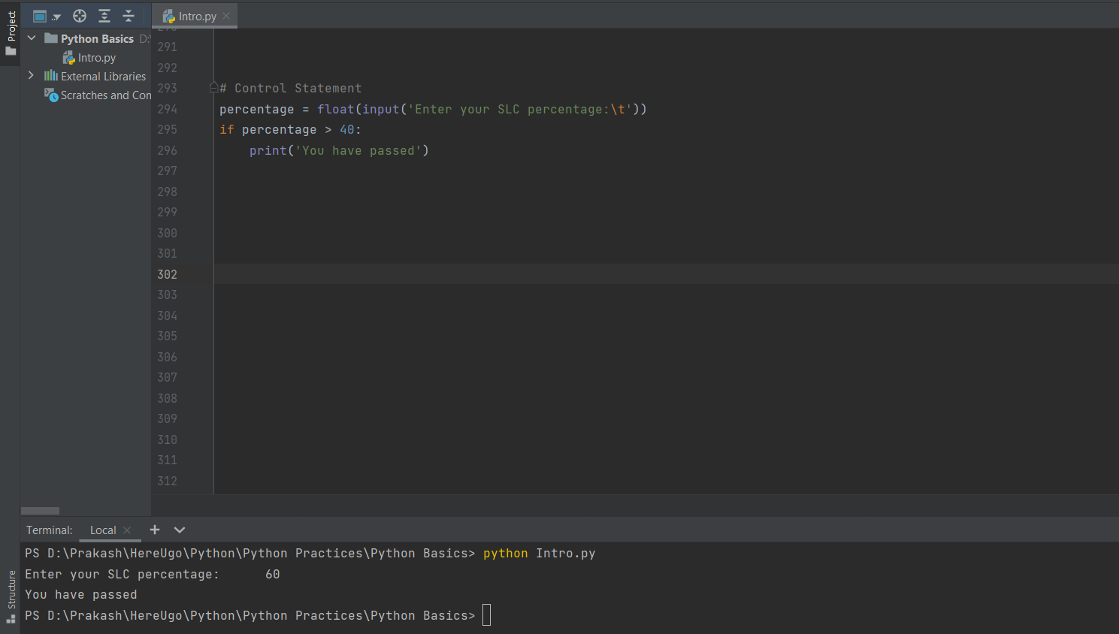
if Statement
The boolean expression after the if statement is called the condition.

Slide 4
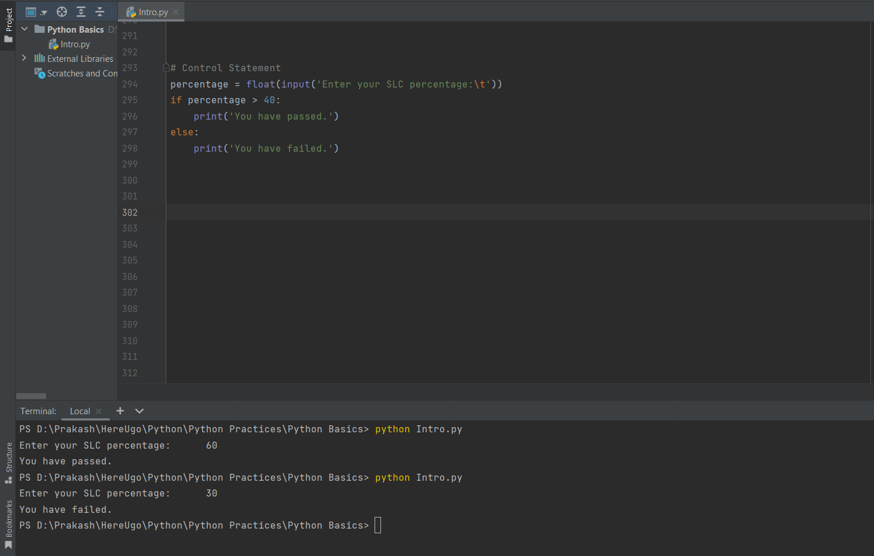
if-else Statement
A second form of the if statement is alternative execution, in which there are two possibilities and the condition determines which one gets executed.

Slide 5
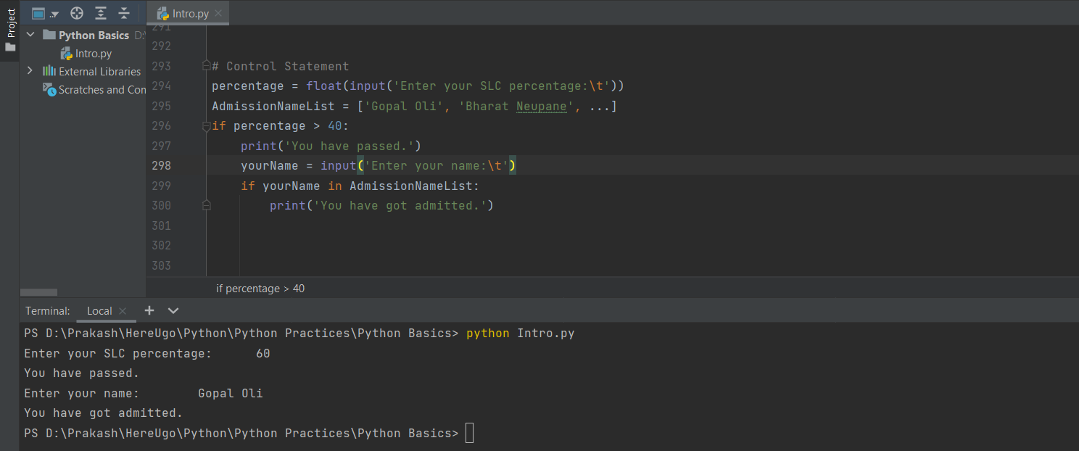
Nested if Statement
If ‘if statement’ comes inside another ‘if statement’ then it is called ‘nested if statement’.

Slide 6
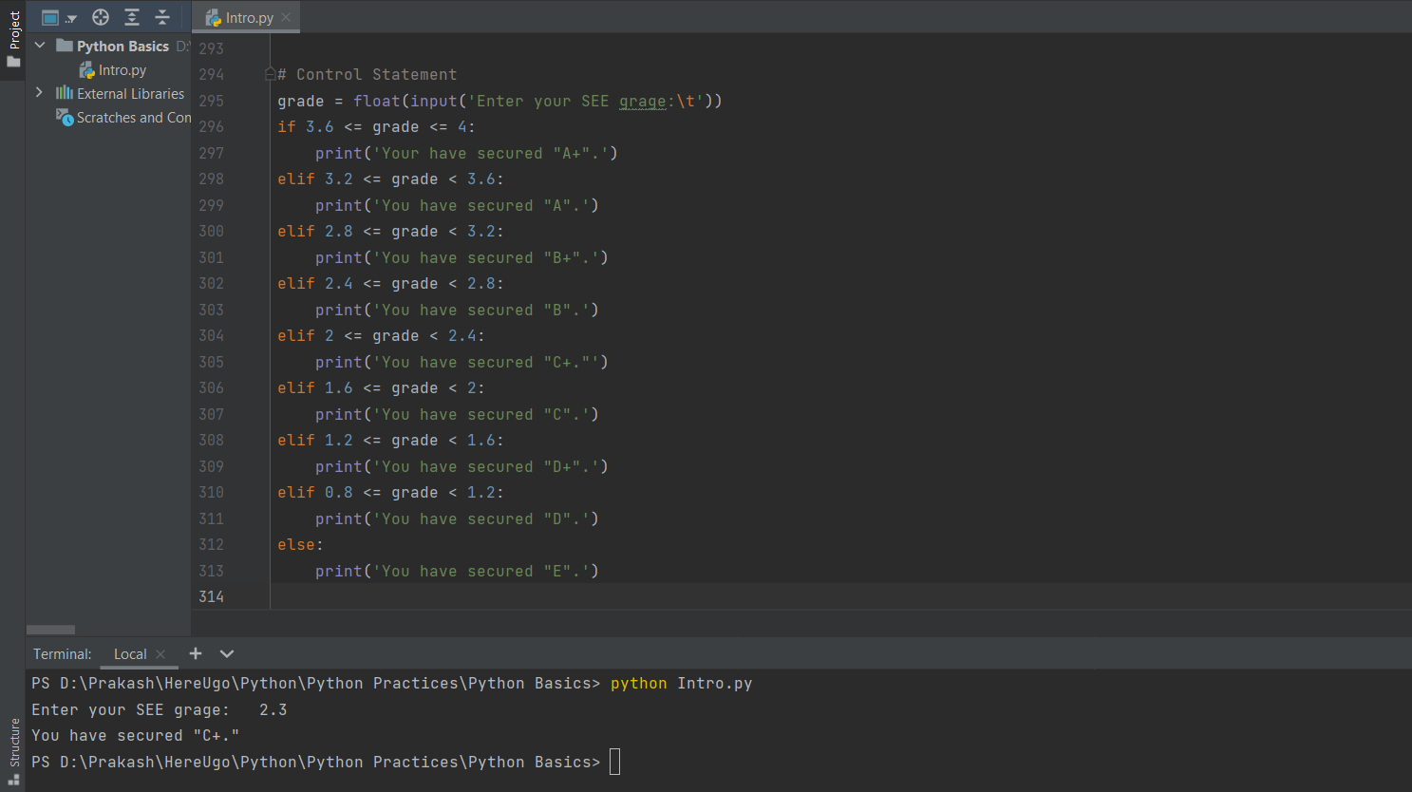
elif Statement
The if-else statement is used to execute both the true part and the false part of a given condition.

Slide 7
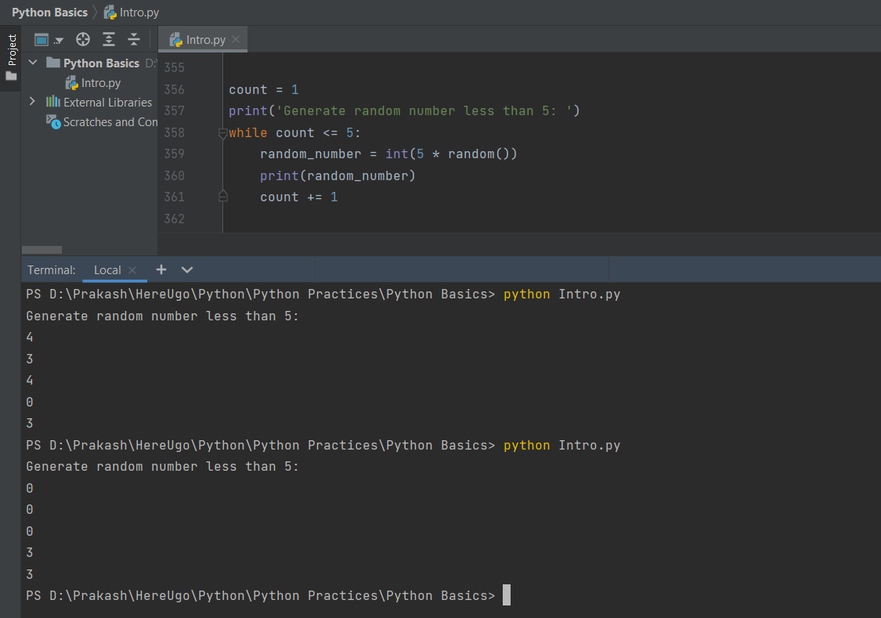
while Loop
The statements of the while loop are executed repeatedly as long as the condition is True.

